Slide 1
www.fhcn.org

Slide 2
Trade Area Tulare and Kings Counties
12 Clinical Sites in 9 Cities
Over 100,00 patients treated annually.

Slide 3
Scope of Services
-Medical
Dental
Behavioral Health
Complementary/Alternative
Medicine
Chiropractic
Nutritional
Health Education.

Slide 4
Who We Serve
Mission: “We provide quality health care to everyone in the communities we serve.”
-Patient population from “all walks of life.”
75% of our patients are of Hispanic origin.
-44% speak a language other than English
Many patients seasonal or migrant farm workers.

Slide 5
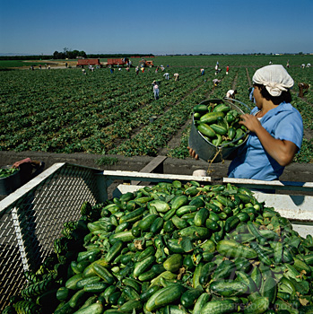
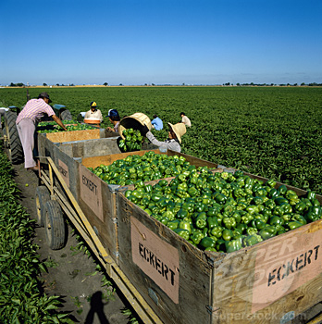
San Joaquin Valley Agriculture

Slide 6
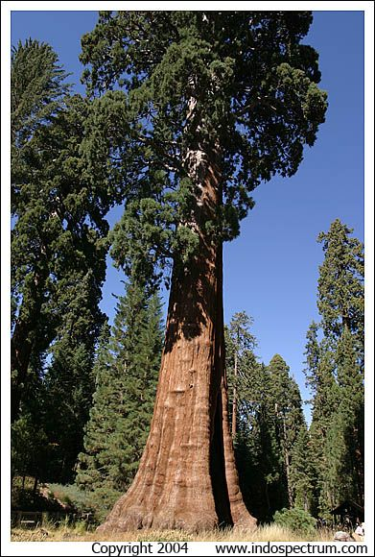
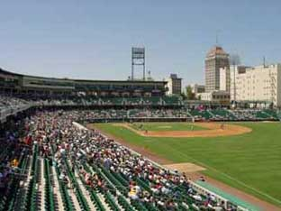
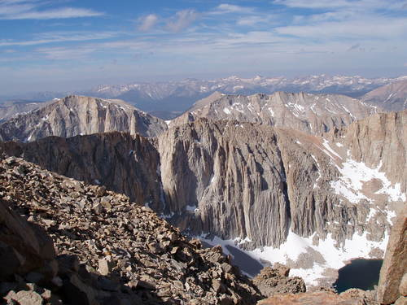
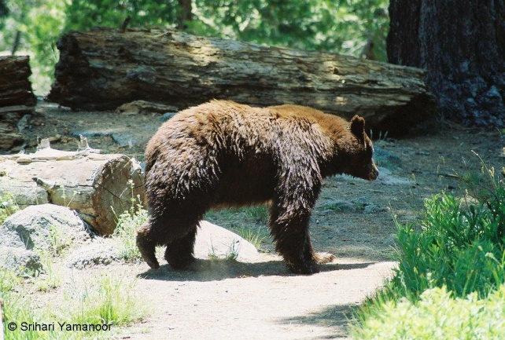
Central California Living

Slide 7
What to expect
Patient Centered Experience
Level III Patient Centered Health Home Recognition by National Committee for Quality Assurance (NCQA).
Opportunities to participate in integrated health care delivery with exposure to all health services available within our facilities.
Be part of our team.
ATSU students are considered part of the FHCN family and are completely integrated in to our care team!

